Slide 1
CROM Metadata Management
Jay Sengupta
Dec 21, 2016

Slide 2

Objective
Incorporate metadata activities in the lower environments as part of CROM Sprint cycles. It includes the following activities
Data Profiling
Data Lineage
Data Linkage
Notes:
usi

Slide 3
Data Profiling
Process
Ab Initio Express>It tool used for Data Profiling
Source Datasets identified by Data Analysts are copied to the Dev Environment
Data Analyst profiles the source dataset and the results are available in user sandbox and it can then be published to EME technical repository.
Accomplishments
EME project required for Data Profiling for CROM Data Migration project created
Benefits
Increased efficiency running Profiling using the Ab Initio tool compared to prior Adhoc manual process
Identifies data patterns and data anomalies that help define the Data Transformation rules during the Design phase compared to finding defects during IST
Notes:
usi

Slide 4
Data Lineage
Process
Technical metadata is imported in the IST Metadata Hub instance post completion of the IST during the sprint cycle.
The technical metadata is imported using Ab Initio extractors owned by EMM. The Import feeds are run weekly via Autosys.
Impact Analysis is run to identify issues in the lineage. All issues are remediated and the metadata is reimported before migrating to UAT platform.
Accomplishments
Successfully created the Lane 3 EME Technical Repository in IST
Populated the Lane 3 EME TR with over 40 different EME TR Projects (6,719 graphs and Psets, 13,399 Data Sets )
Imported approximately 308 Teradata databases from the EIWS environment that will align with the Lane 3 EME TR data references from those graphs and Psets.
Created approximately 350 new Application entries and the accompanying Application Assignment entries to associate the new objects in the Lane 3 repository to unique application entries created specifically for them.
Benefits
Identification and Remediation of Lineage issues in IST environment
Cleaner migration of technical metadata in UAT and Production environments
Notes:
usi

Slide 5
Data Linkage
Process
Load Business Metadata to PROD.
Load Business Metadata to SIT from PROD.
Import Technical Metadata into SIT (Lane 3) from SIT MIDE/CRoM Databases.
Create Linkage in SIT. Repeat
Load Business Metadata to UAT from SIT.
Import Technical Metadata into UAT from UAT MIDE/CRoM Databases.
Create Linkage in UAT.
Import Technical Metadata into PROD from PROD MIDE/CRoM Databases.
Create Linkage on PROD.
Accomplishments
Created the Linkage spreadsheet that is used for importing into Metadata Hub (Sample spreadsheet available in Appendix).
Benefits
Identification and Remediation of Linkage issues in IST environment
Cleaner Data Linkage creation in UAT and Production environments
Notes:
usi

Slide 6
Appendix

Slide 7
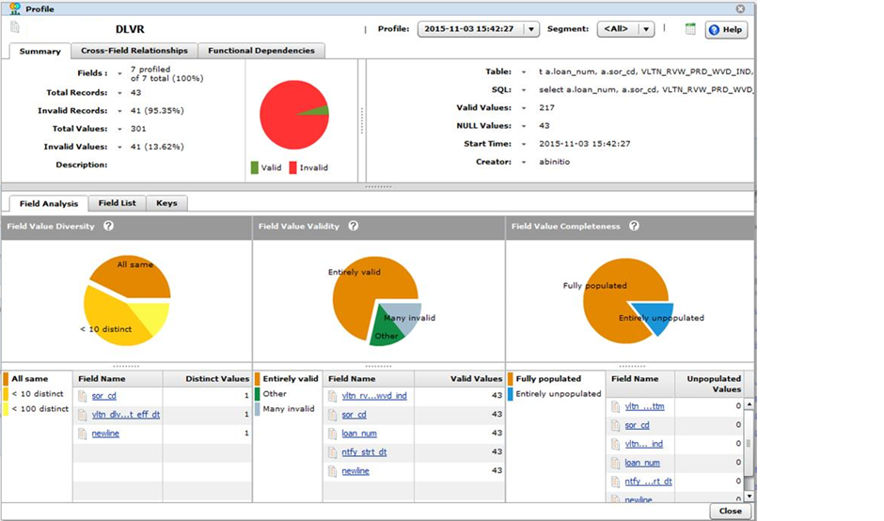
Data Profiling Results Snapshot
Notes:
usi

Slide 8
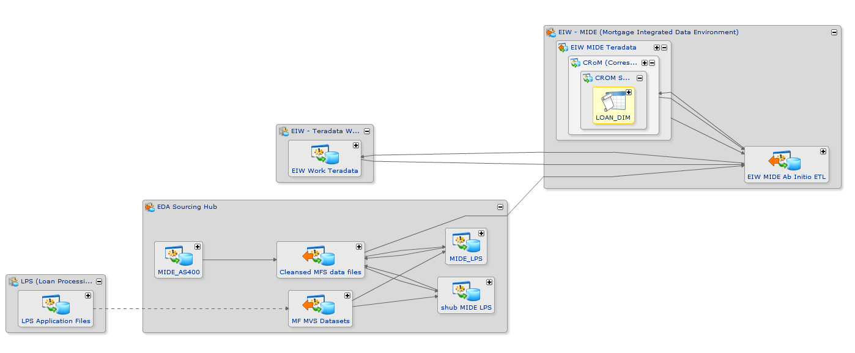
Data Lineage for Sample CROM Entity
Notes:
usi

Slide 9
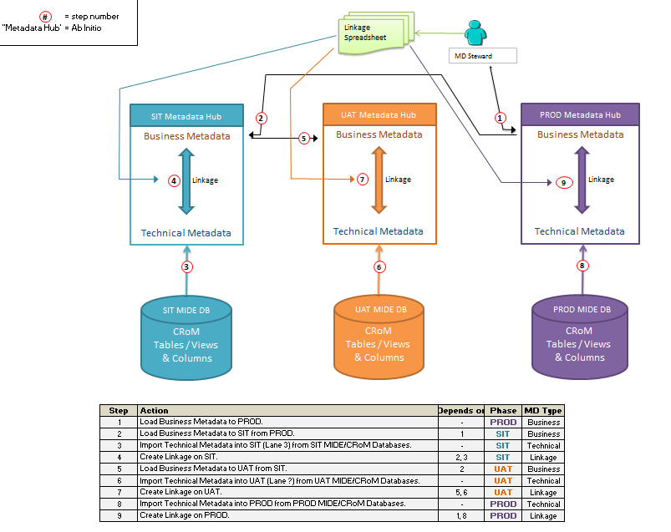
Data Linkage Process Flow
Notes:
usi

Slide 10
Data Linkage Sample Spreadsheet
Notes:
usi

